Slide 1
Charging our future:
Electric vehicles
BAIT 518 Presentation
October 27, 2023
Presented by BA1 Group B
Alisa, Coco, Sergio, Young Ji, Yuehan

Slide 2
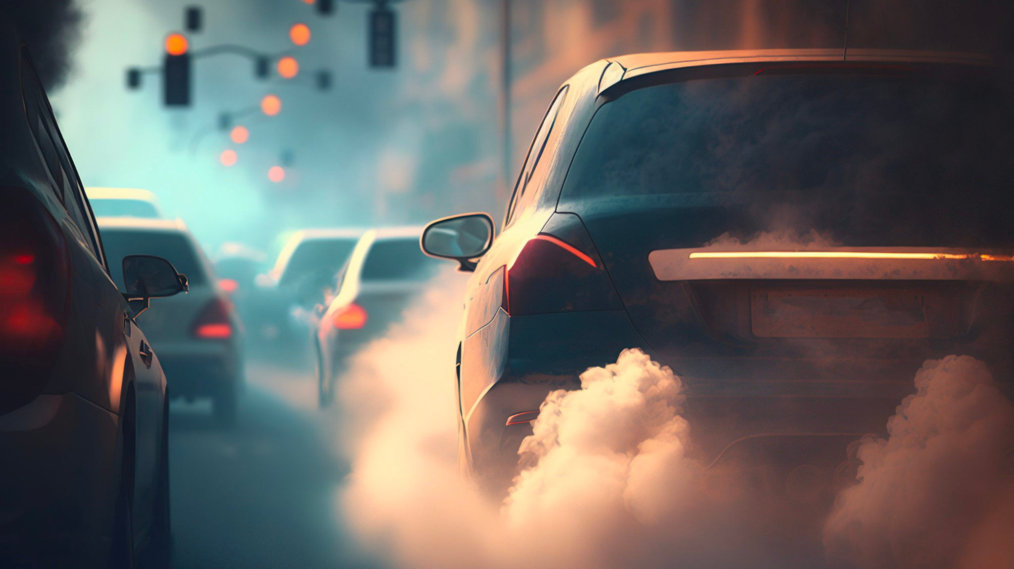
Image from How it works (2023)

Slide 3


Goal
Provide insights
Make informed decisions

Slide 4
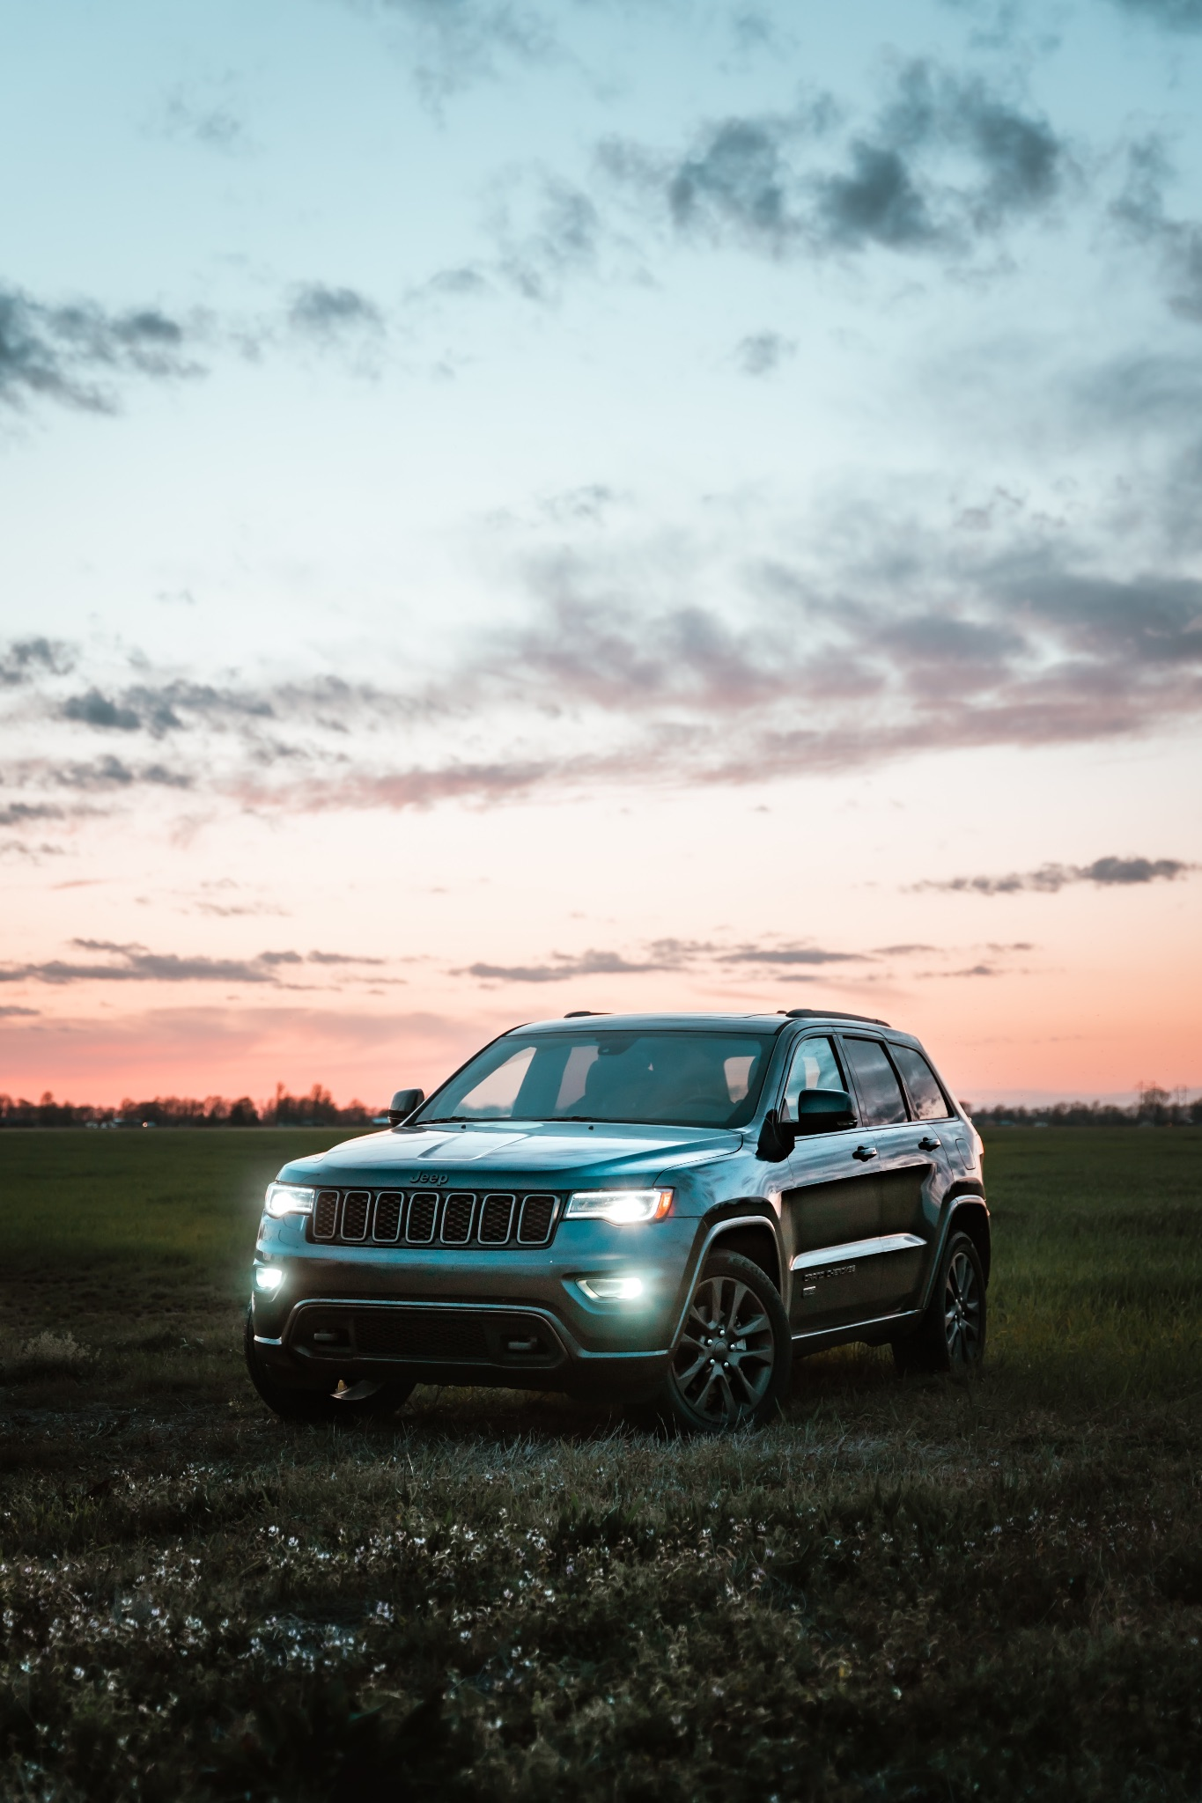
Data & Metrics
Data
Fuel economy data for vehicles released in the US from 1985-2023.
Source
The US department of energy, Kaggle.com
Key Metrics
Model year
Fuel type
Vehicle class
Combined MPG or equivalent
Image from Unsplash (2021)

Slide 5
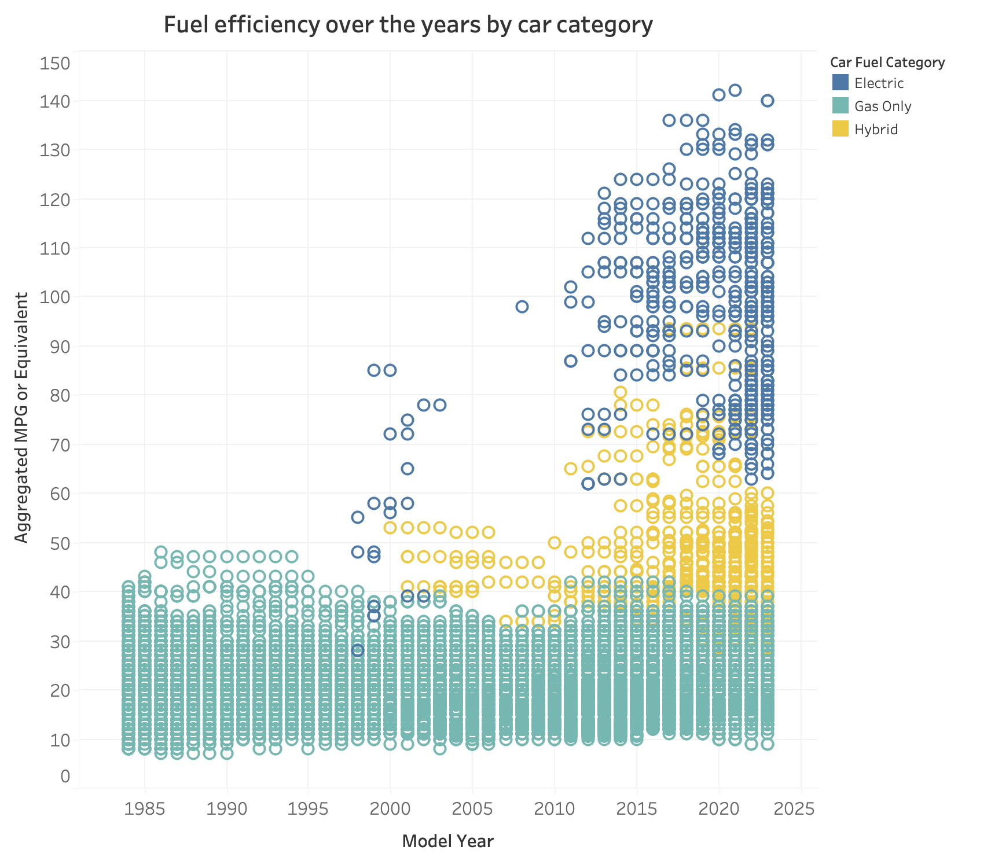
What has been the fuel economy of vehicles over time?
Steady increase in EV fuel efficiency.
Not meaningful improvements for gas-powered cars.
Hybrid cars are a good alternative.

Slide 6
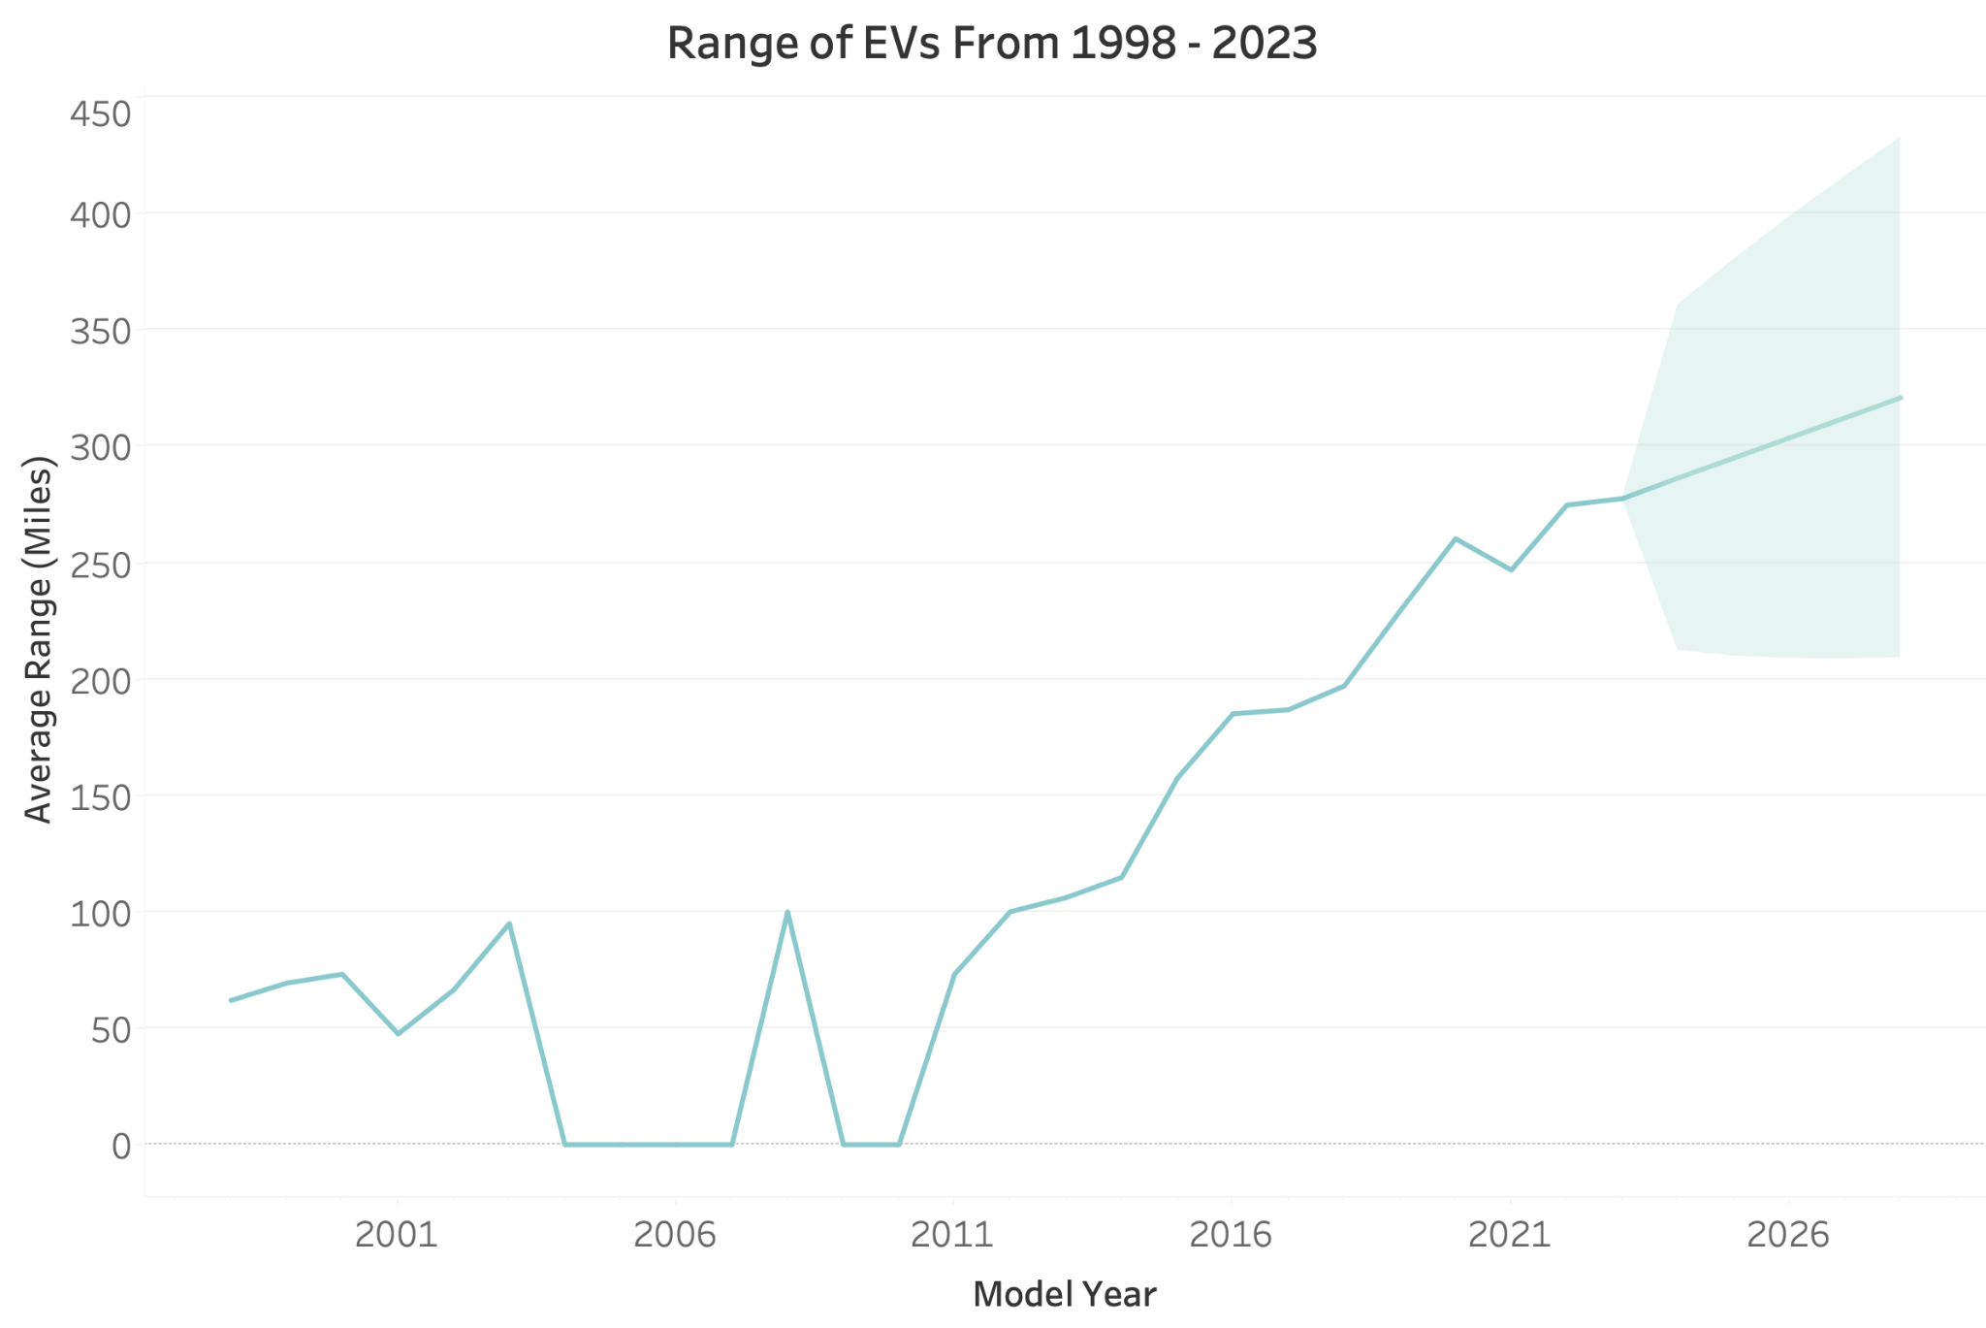
How has the range of EVs changed over time?

Slide 7
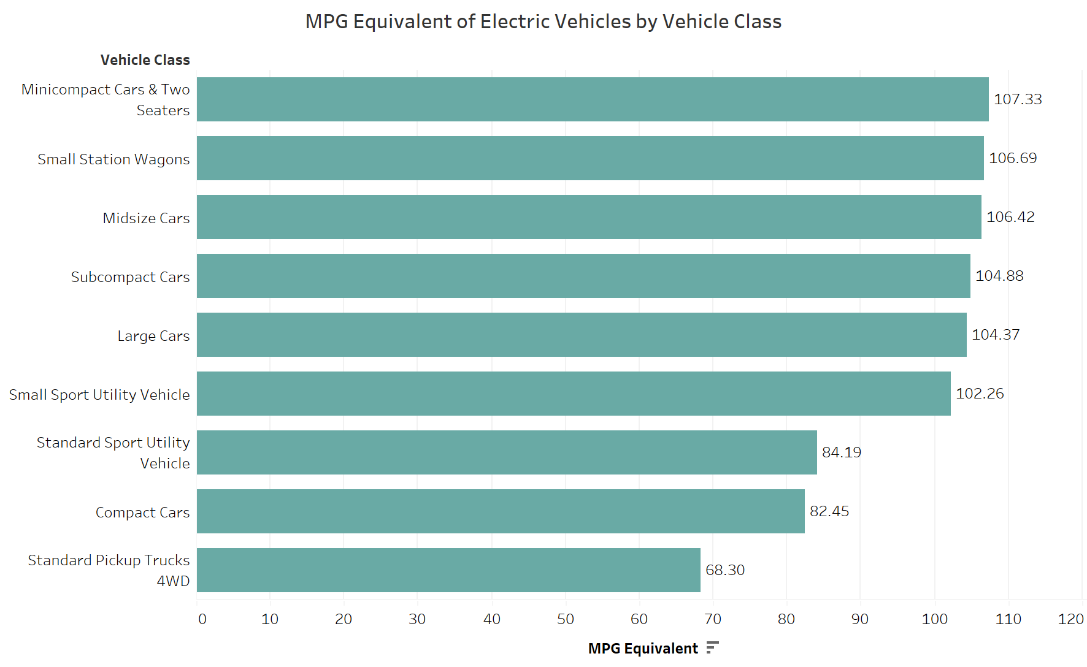
What is the fuel efficiency of different electric vehicle classes in recent years?

Slide 8
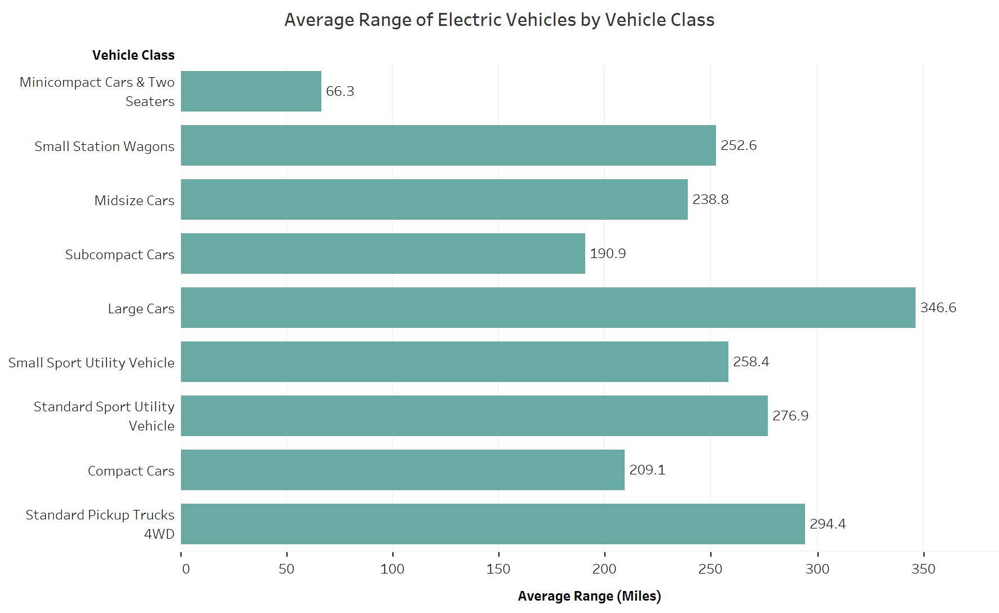
What is the range
of different electric vehicle classes in recent years?

Slide 9

Recommendations
Consider making an EV your next car purchase
Better fuel efficiency relative to other fuel types
Improvements in range over time
Consider relative fuel efficiency and range
Smaller cars have better fuel efficiency
Larger cars have better range
Image from Unsplash (2021)

Slide 10

Thank you
Image from Unsplash (2016)

Slide 11
References
How it Works. (2023). Scope 3 emissions and employee commuting: The hidden impacts of solo driving. How it Works. https://pavecommute.app/understanding-scope-3-emissions-the-hidden-impact-of-commuter-transportation/
Thornton, K. (2021). Gray bmw x 6 on green grass field during sunset [image]. Unsplash. https://unsplash.com/photos/gray-bmw-x-6-on-green-grass-field-during-sunset-8scCtYs4Dp8
Crownhard, C. (December 22, 2022). Why EVs won’t replace hybrid cars anytime soon. Climate Change and Energy. https://www.technologyreview.com/2022/12/22/1065830/why-evs-wont-replace-hybrid-cars-anytime-soon/
Bohovyk, Olena. (2021). Red car in the middle of the forest during daytime photo [image]. Unsplash. https://unsplash.com/photos/red-car-in-the-middle-of-the-forest-during-daytime-cXVoDxe71BQ
Geronimo. (2016). Aerial shot of road surrounded by green trees photo [image]. Unsplash. https://unsplash.com/photos/aerial-shot-of-road-surrounded-by-green-trees-qzgN45hseN0

Slide 12
Additional Information (Cost)
A 2020 Consumer Reports study similarly showed that EV drivers tend to spend about 60 percent less each year on fuel costs compared to drivers of gas-powered cars.
However, the overall cost depends on various factors such as:
Cost of electricity based on location
Cost of charging at charging stations
Fuel efficiency of cars
Without spark plugs to replace or oil to change, electric vehicles have a clear leg up on maintenance costs. Electric cars do still require some basic maintenance—like service checks and tire rotations. But in general, electric vehicles typically cost half as much to maintain and repair as gas-powered cars.
https://www.nrdc.org/stories/electric-vs-gas-cars-it-cheaper-drive-ev

